Slide 1
CS305 - Social, Ethical, and Legal Issues
Instructor: Nguyen Van Vu

Slide 2
Ethical issues of BitTorrent
Quoc Lap Trieu Advanced Program in Computer Science Faculty of Information Technology University of Science, VNU-HCM Email: tqlap@apcs.vn
Thien Thai Advanced Program in Computer Science Faculty of Information Technology University of Science, VNU-HCM Email: tthien@apcs.vn

Slide 3
I. Introduction

Slide 4
Introduction
Internet has been considered as one of the vital factors for the development of society.
The needs of transferring large data between people through the use of Internet increase.

Slide 5
Introduction
Peer-to-peer network model was invented.
Peer-to-peer file sharing protocol such as BitTorrent was used to shared copyrighted materials.

Slide 6
Introduction
We will debate this phenomenon using theories of ethics.

Slide 7
II. Background

Slide 8
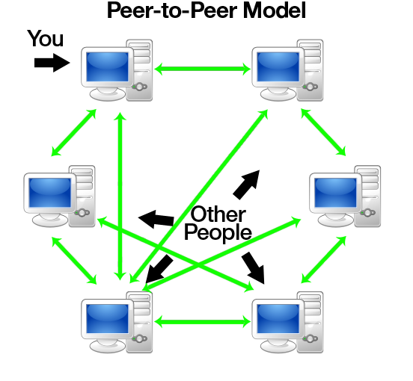
Background
No central server
Peers have equally privileged
Each peers share their resource to network
source: http://www.codeproject.com/KB/WCF/614028/pto1.png

Slide 9
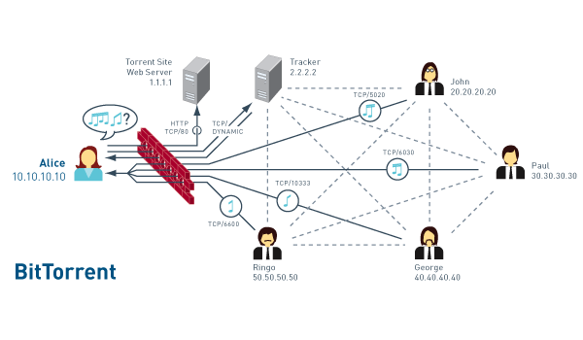
Background
Get .torrent from torrent site
Get peer info from tracker
Connect to peers
File are transfer between peers
https://dougvitale.files.wordpress.com/2012/02/bittorrent-network-flow2.gif?w=700

Slide 10
III. METHODOLOGY

Slide 11
Subjective Relativism
Users :
+ Convenience, easy to use
+ Save money (especially for get pirated material)
- Copyright owners: Hurt their sale.
- ISP: consume a lot of bandwidth

Slide 12
Cultural Relativism
+ Switzerland: personal use
+ Vietnam: personal use + commerce (such as sell DVD for profit).
+ Canada, US, UK : illegal

Slide 13
Divine Command
“You shall not steal.” (Exodus 20:15)
“Cursed is the one who moves his neighbor's landmark” (Deuteronomy 27:17)
=>It is wrong to download copyrighted materials via BitTorrent.

Slide 14
Kantianism
- Users Retrieving copyrighted contents:
+ Save their money.
+ Easy and quick way
Creators:
+ Gain nothing.
+ Affecting their profits
=> Use the creators as the mean to an end.

Slide 15
Act Utilitarianism
- The case: sharing a movie using BitTorrent.
-Benefit: Free
-Harm:
+ Companies, cinemas… lose their profits
+ Unemployment
+ Effects on economy
Harm > Benefit => it is wrong

Slide 16
Rule Utilitarianism
If this action is followed by everyone:
-Benefit: Save some money.
-Harm:
+ Affect creators’ profits.
+ No one wants to create new products.
Harm > Benefit => it is wrong

Slide 17
Social Contract
- A voluntary agreement between individuals for their mutual benefit.
- Consider the case: a novelist
+ what does he have in return?
+ what do readers have to do?
+What if they break the rule.

Slide 18
Conclusion
After evaluating, 5 ethical theories prove it is wrong to piracy copyrighted contents.
Therefore, we shouldn’t use BitTorrent to sharing copyrighted material.
=> BitTorrent is legal, the ways people uses it is illegal.

Slide 19
Thank you for listening

Slide 20
Reference
Peer-to-peer model image http://www.codeproject.com/KB/WCF/614028/pto1.png
BitTorrent image https://dougvitale.files.wordpress.com/2012/02/bittorrent-network-flow2.gif?w=700
[1] B. M. Leiner, V. G. Cerf, D. D. Clark, R. E. Kahn, L. Kleinrock, D. C. Lynch, J. Postel, L. G. Roberts, and S. Wolff, “A brief history of the internet,” SIGCOMM Comput. Commun. Rev., vol. 39, no. 5, pp. 22–31, Oct. 2009. [Online]. Available: http://doi.acm.org/10.1145/1629607.1629613 [2] M. Parameswaran, A. Susarla, and A. B. Whinston, “P2p networking: An information-sharing alternative,” Computer, vol. 34, no. 7, pp. 31–38, 2001. [3] R. Schollmeier, “A definition of peer-to-peer networking for the classification of peer-to-peer architectures and applications,” in Peer-to-Peer Computing, 2001. Proceedings. First International Conference on, 2001, pp. 101–102. [4] “How bit torrent works,” last access August 12, 2015. [Online]. Available: http://computer.howstuffworks.com/bittorrent1.htm

Slide 21
Reference
[5] “How p2p file sharing,” last access August 12, 2015. [Online]. Available: http://www.makeuseof.com/tag/p2p-peer-peer-file-sharing-works/ [6] J. Tyson, “How the old napster worked,” Web Page: HowStuffWorks (R), Archived at http://web.archive.org, 2005. [7] G. Douglas, “Copyright and peer-to-peer music file sharing: The napster case and the argument against legislative reform,” Murdoch University Electronic Journal of Law, vol. 11, no. 1, 2004. [8] S. Watson, “How kazaa works,” HowStuffWorks.¡ http://computer. howstuffworks. com/kazaa3. htm, 2008. [9] B. Cohen, “Bittorrenta new p2p app,” Yahoo eGroups, 2001. [10] “Bittorrents future? dht, pex and magnet links explained,” last access August 16, 2015. [Online]. Available: https://torrentfreak.com/bittorrentsfuture-dht-pex-and-magnet-links-explained-091120/ [11] “What is intellectual property?” last access August 16, 2015. [Online]. Available: http://www.wipo.int/about-ip/en/ [12] “Piracy (intellectual property) definition,” last access August 16, 2015. [Online]. Available: http://www.duhaime.org/LegalDictionary/P/PiracyIntellectualProperty.aspx [13] “The pirate bay,” last access August 16, 2015. [Online]. Available: https://thepiratebay.vg/

Slide 22
Reference
[14] “Kickasstorrent,” last access August 16, 2015. [Online]. Available: http://kat.cr/ [15] S. Bright, “Current state of bittorrent in international law: Why copyright law is ineffective and what needs to change, the,” New Eng. J. Int’l & Comp. L., vol. 17, p. 265, 2011. [16] G. Siganos, J. M. Pujol, and P. Rodriguez, “Monitoring the bittorrent monitors: A birds eye view,” in Passive and Active Network Measurement. Springer, 2009, pp. 175–184. [17] M. J. Quinn, Ethics for the information age. Pearson, 2014. [18] “Safest countries to download torrents,” last access August 12, 2015. [Online]. Available: http://www.best-bittorrent-vpn.com/-safestcountries-to-download-torrents.html [19] “What are the dangers of torrents?” last access August 16, 2015. [Online]. Available: http://www.aph.gov.au/sitecore/content/Home/Parliamentary Business/Bills Legislation/Bills Search Results/Result?bId=r5375 [20] “Copyright infringement and remedies,” Copyright Law of the United States of America, last access August 16, 2015. [Online]. Available: http://copyright.gov/title17/92chap5.html [21] Exodus 20:15. [22] Deuteronomy 27:17. [23] “Is the bible relevant to intellectual property?” last access August 16, 2015. [Online]. Available: http://www.hbu.edu/ChoosingHBU/Academics/Colleges-Schools/School-of-Business/Center-forChristianity-in-Business-(CCB)/The-Kingdom-Economy-TKE/ccbtkelegal-corner/2014/April/Is-The-Bible-Relevant-To-IntellectualProperty.aspx [24] “Bittorrent ethics: Punishing piracy or criminalizing sharing?” last access August 16, 2015. [Online]. Available: http://www.rt.com/opedge/torrent-piracy-sharing-law-440/ [25] “What are the dangers of torrents?” last access August 16, 2015. [Online]. Available: http://smallbusiness.chron.com/dangers-torrents- 70661.html

